Slide 1


MIT School of Computing Department of Computer Science & Engineering
Third Year Engineering
23CSE3011 - Design and Analysis of Algorithms
Class - T.Y. (SEM-V)
Unit - I
Fundamentals of Algorithm
PLD
AY 2026-2027 SEM-V

Slide 2
MIT School of Computing Department of Computer Science & Engineering
UNIT - I
SYLLABUS
What is algorithm, Fundamentals of algorithmic problem solving
The Analysis Framework: Measuring an Input’s Size, Units for Measuring Running Time, Orders of Growth, Worst-Case, Best-Case, and Average-Case Efficiencies
Asymptotic notations: Asymptotic complexities calculations for given function
Mathematical Analysis of Non recursive Algorithms: Finding the value of largest element in the list, element uniqueness problem.
Mathematical Analysis of Recursive Algorithms: Factorial function
Master Theorem: Solving recurrence relations using master theorem.
PLD

Slide 3
MIT School of Computing Department of Computer Science & Engineering
What is algorithm
A finite set of instruction that specify a sequence of operations to be carried out in order to solve a specific problem or class of problems is called an algorithm.
OR
Algorithm is defined as a step by step procedure to perform a specific task within finite number of steps.
PLD

Slide 4
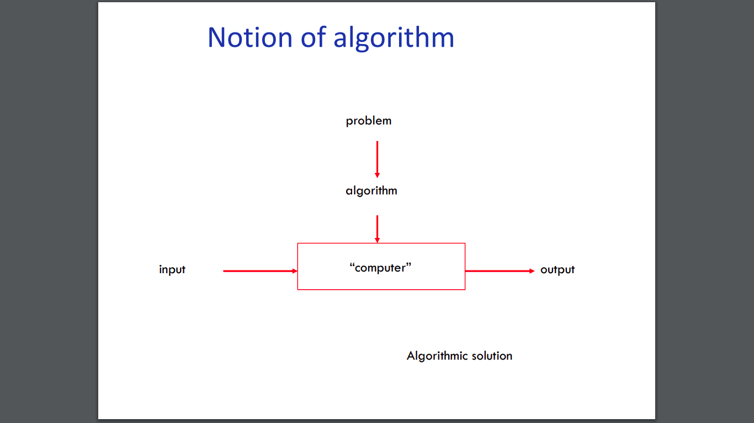
MIT School of Computing Department of Computer Science & Engineering
What is algorithm
PLD

Slide 5
MIT School of Computing Department of Computer Science & Engineering
PSEUDOCODE
Pseudocode (pronounced SOO-doh-kohd) is a detailed yet readable description of what a computer program or algorithm must do, expressed in a formally-styled natural language rather than in a programming language.
It is sometimes used as a detailed step in the process of developing a program. It allows programmers to express the design in great detail and provides programmers a detailed template for the next step of writing code in a specific programming language.
PLD

Slide 6
MIT School of Computing Department of Computer Science & Engineering
PSEUDOCODE - find the sum of numbers
intN, sum = 0, i = 1
Input N from user.
do,
sum = sum + i.
i = i + 1.
Repeat step 3 to 5 till
i < = N.
Display the value of sum.
PLD

Slide 7
MIT School of Computing Department of Computer Science & Engineering
Fundamentals of algorithmic - problem solving
Every algorithm should have the following 5 characteristic features:
a) Input
b) Output
c) Finiteness
d) Definiteness
e) Effectiveness
PLD

Slide 8
MIT School of Computing Department of Computer Science & Engineering
Fundamentals of algorithmic problem solving
a) Input: An algorithm may have zero or one or more inputs. The inputs are taken from a specified set of subjects or values (input domain).
The input pattern may be texts, images or any type of files.
For example:
Zero inputs: An algorithm that prints "Hello, World!" or displays the current date without requiring user input.
One input: An algorithm that computes the square of a number.
Multiple inputs: An algorithm that adds two numbers or sorts a list of numbers.
PLD

Slide 9
MIT School of Computing Department of Computer Science & Engineering
Fundamentals of algorithmic problem solving
b) Output: An algorithm may have one or more outputs. Output is basically a quantity which has a specified relation with the input.
c) Finiteness: An algorithm should terminate after a countable number of steps. In some cases the repetition of steps may be larger in number. If a procedure is able to resolve in finite number of execution of steps, then it is referred to be computational method.
PLD

Slide 10
MIT School of Computing Department of Computer Science & Engineering
Fundamentals of Algorithmic Problem Solving
d) Definiteness: Each step of an algorithm must be precisely defined. Due to the lack of understandability one may think that the step might be lacking definiteness. Therefore in such cases mathematically expressions are written, so that it resembles the instruction of any computer language.
e) Effectiveness: An algorithm is generally expected to effective. Means the steps should be sufficiently basic, so that it may be possible for a man to resolve them.
PLD

Slide 11
MIT School of Computing Department of Computer Science & Engineering
Expectation from an Algorithm
Correctness : Produced by the algorithm should correct.
Approximation : Exact solution is not found, but near
optimal solution can be found out
Generality : Algorithm applies to set of standard inputs.
Less resource usage: Algorithms should use less resources (time
and space).
PLD

Slide 12
MIT School of Computing Department of Computer Science & Engineering
What is Computer algorithm?
“A set of steps to accomplish or complete a task that is described precisely enough that a computer can run it.”
These algorithms run on computers or computational devices.
For Example:
GPS in our smartphones - GPS uses shortest path algorithm.
Online shopping - uses cryptography which uses RSA
algorithm
Tea making algorithm - very difficult for a machine to know
how much water, milk to be added
PLD

Slide 13
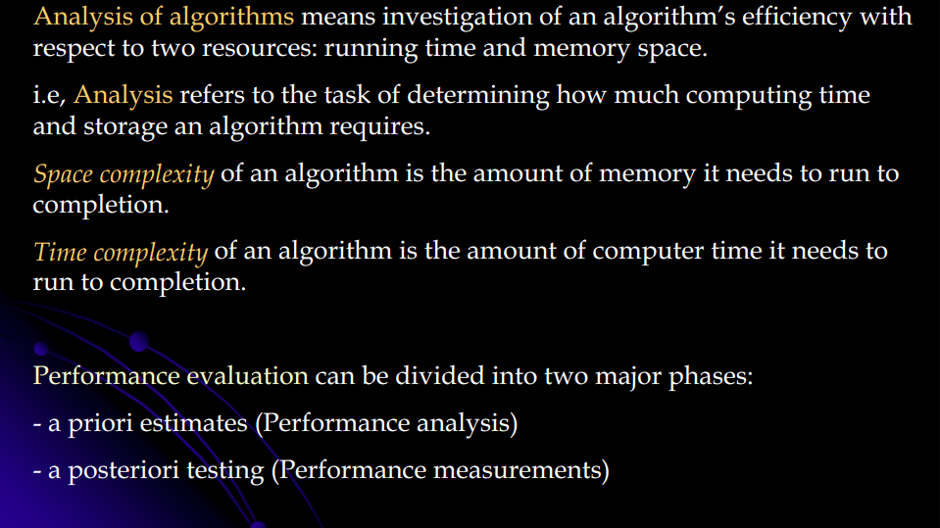
MIT School of Computing Department of Computer Science & Engineering
The Analysis Framework -
PLD

Slide 14
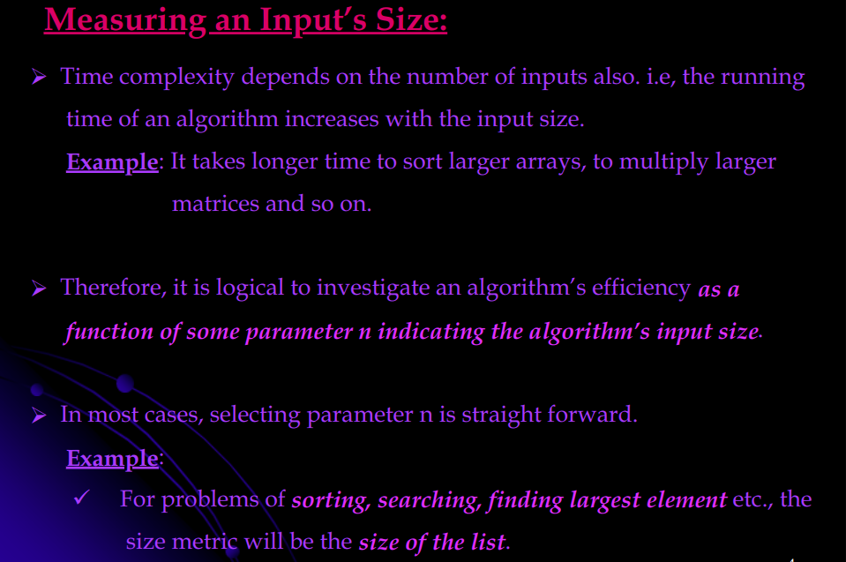
MIT School of Computing Department of Computer Science & Engineering
The Analysis Framework:
PLD

Slide 15
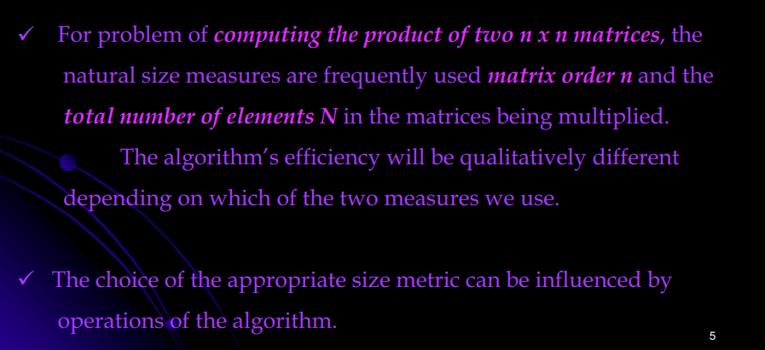
MIT School of Computing Department of Computer Science & Engineering
The Analysis Framework:
PLD

Slide 16
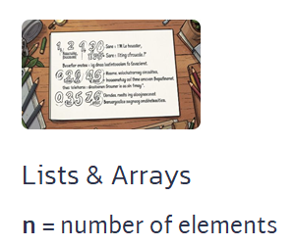
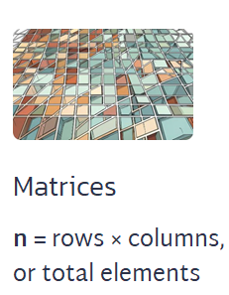
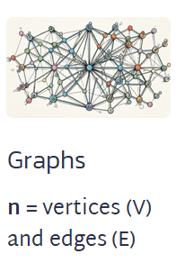
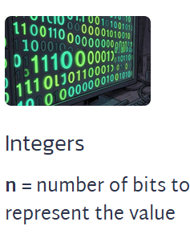
MIT School of Computing Department of Computer Science & Engineering
Measuring Input Size (n): Input size n quantifies the amount of data an algorithm must process. The definition of n depends on the problem
PLD

Slide 17
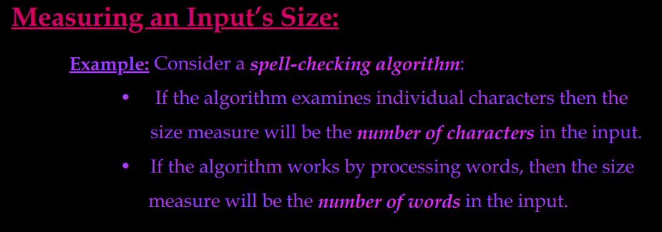
MIT School of Computing Department of Computer Science & Engineering
The Analysis Framework:
PLD

Slide 18
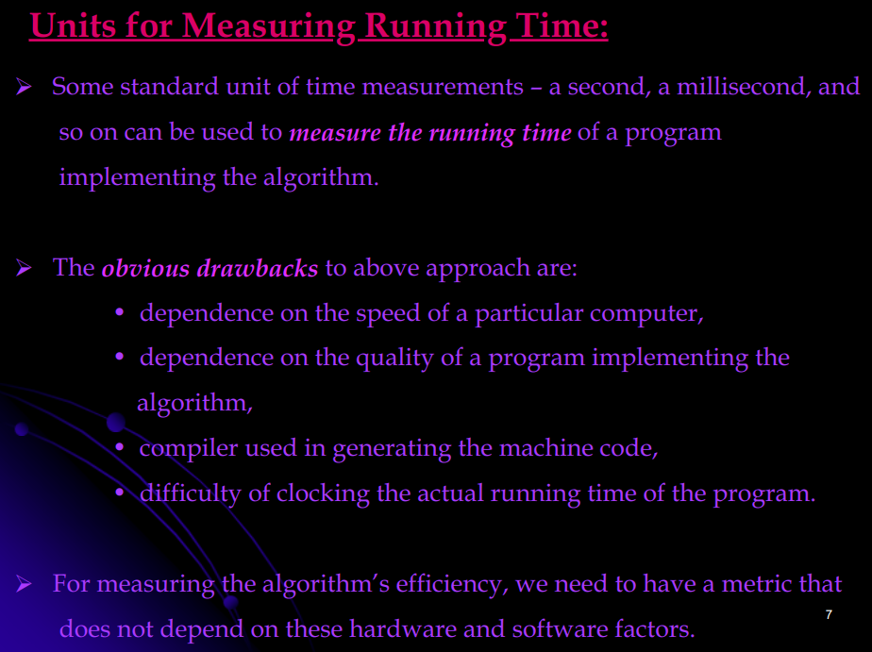
MIT School of Computing Department of Computer Science & Engineering
PLD

Slide 19
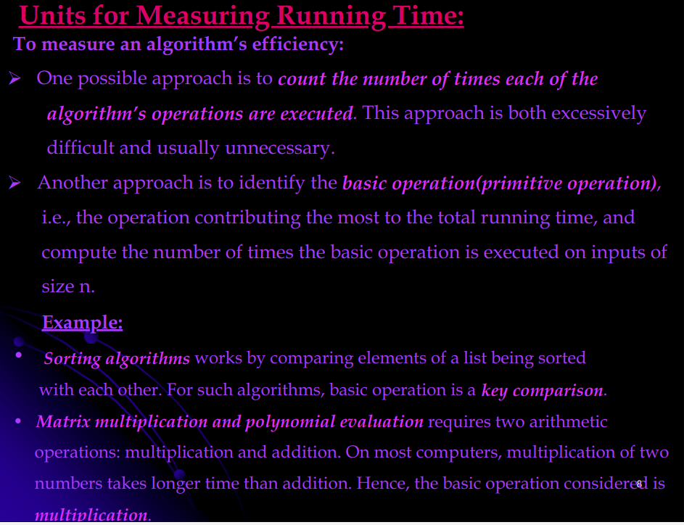
MIT School of Computing Department of Computer Science & Engineering
PLD

Slide 20
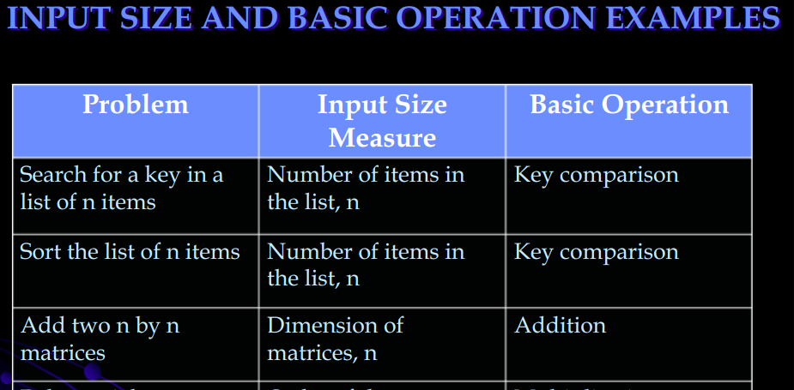
MIT School of Computing Department of Computer Science & Engineering
PLD

Slide 21
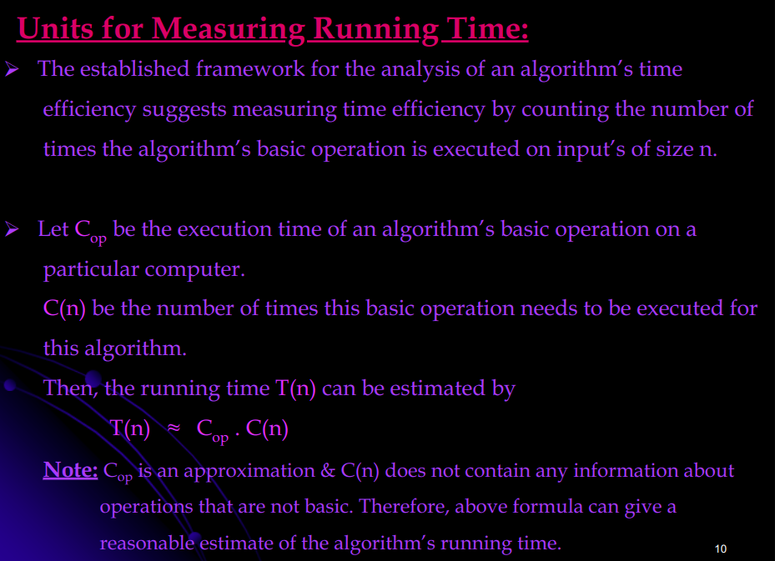
MIT School of Computing Department of Computer Science & Engineering
PLD

Slide 22
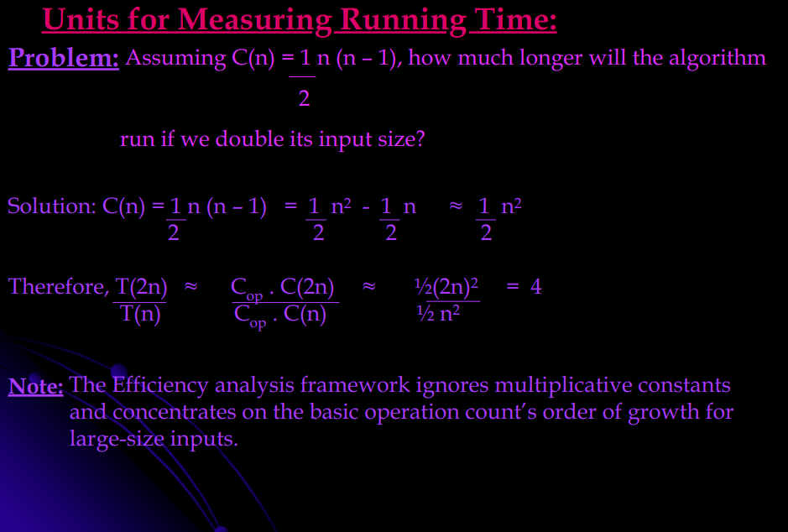
MIT School of Computing Department of Computer Science & Engineering
PLD

Slide 23
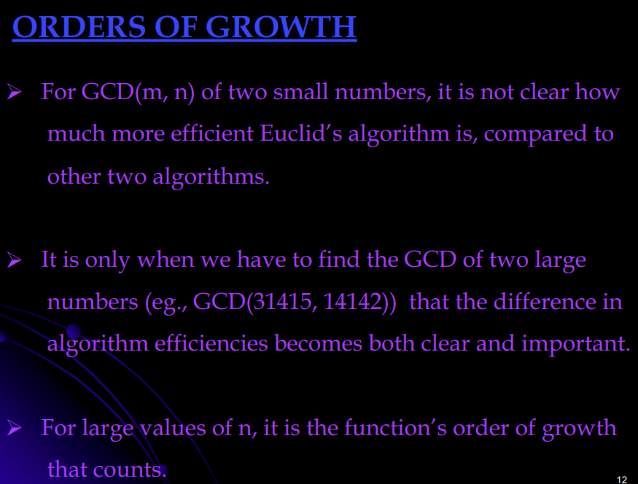
MIT School of Computing Department of Computer Science & Engineering
Order of Growth -
It is described by the highest degree term of the formula for running time. (Drop lower-order terms. Ignore the constant coefficient in the leading term.)
PLD

Slide 24
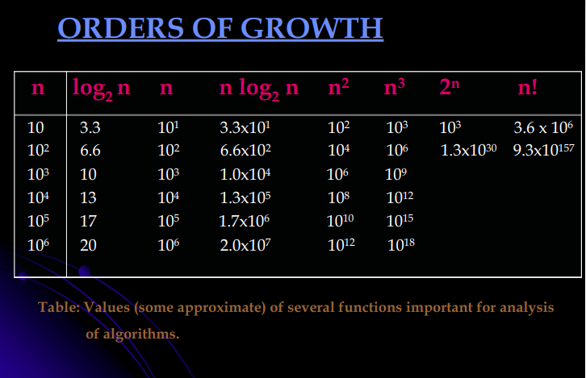
MIT School of Computing Department of Computer Science & Engineering
PLD

Slide 25
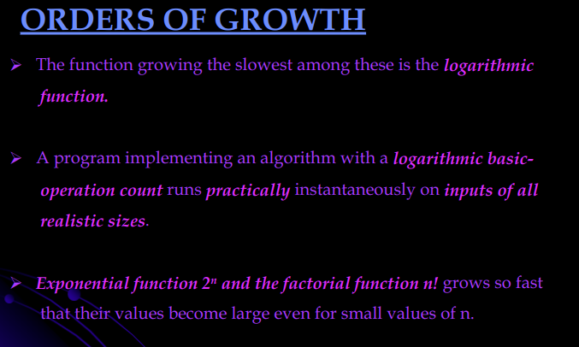
MIT School of Computing Department of Computer Science & Engineering
Order of growth → describes the rate at which an algorithm's resource requirement grows.
PLD

Slide 26
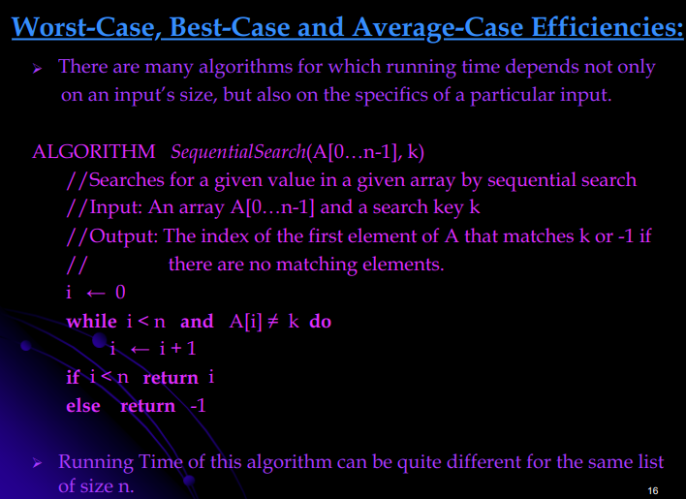
MIT School of Computing Department of Computer Science & Engineering
PLD

Slide 27
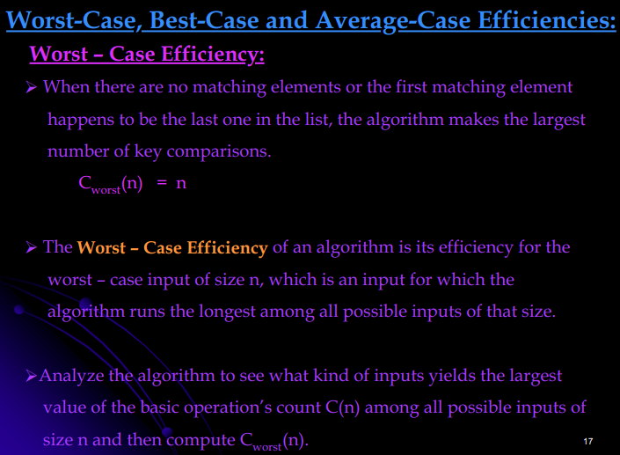
MIT School of Computing Department of Computer Science & Engineering
PLD

Slide 28
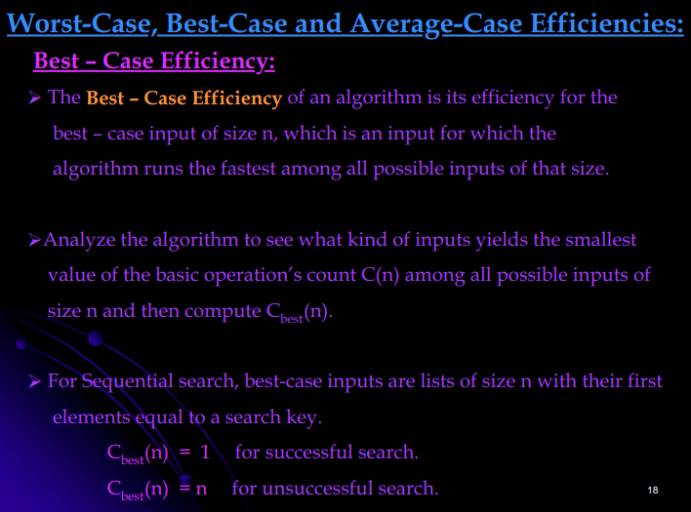
MIT School of Computing Department of Computer Science & Engineering
PLD

Slide 29
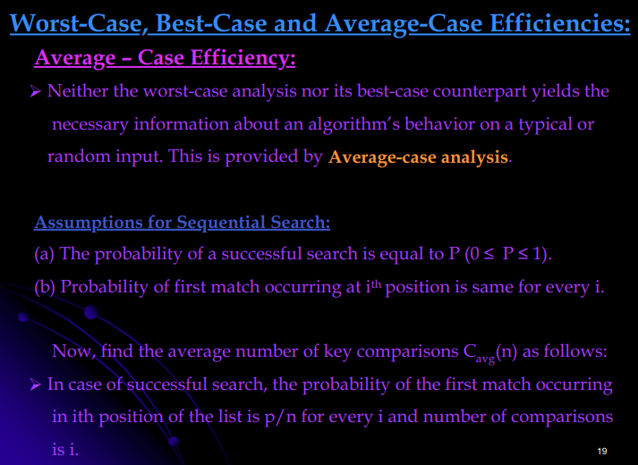
MIT School of Computing Department of Computer Science & Engineering
PLD

Slide 30
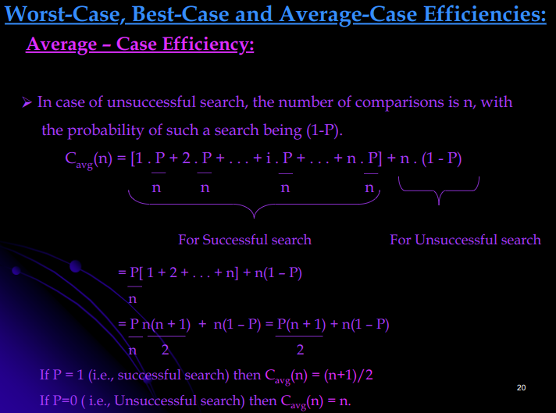
MIT School of Computing Department of Computer Science & Engineering
PLD

Slide 31
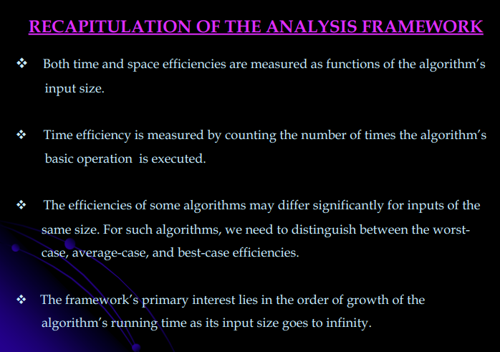
MIT School of Computing Department of Computer Science & Engineering
PLD

Slide 32
MIT School of Computing Department of Computer Science & Engineering
Asymptotic notation -
Asymptotic Notations are mathematical tools used to analyze the performance of algorithms by understanding how their efficiency changes as the input size grows.
These notations provide a concise way to express the behavior of an algorithm's time or space complexity as the input size approaches infinity.
Rather than comparing algorithms directly, asymptotic analysis focuses on understanding the relative growth rates of algorithms' complexities.
It enables comparisons of algorithms' efficiency by abstracting away machine-specific constants and implementation details, focusing instead on fundamental trends.
Asymptotic analysis allows for the comparison of algorithms' space and time complexities by examining their performance characteristics as the input size varies.
By using asymptotic notations, such as Big O, Big Omega, and Big Theta, we can categorize algorithms based on their worst-case, best-case, or average-case time or space complexities, providing valuable insights into their efficiency.
PLD

Slide 33
MIT School of Computing Department of Computer Science & Engineering
Asymptotic Notation Types -
There are mainly three asymptotic notations:
Big-O Notation (O-notation)
Omega Notation (Ω-notation)
Theta Notation (Θ-notation)
PLD

Slide 34
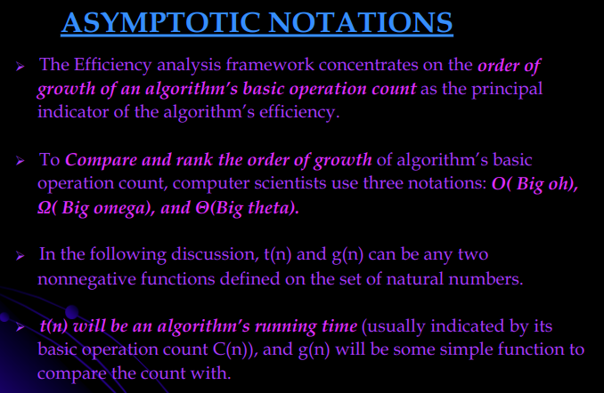
MIT School of Computing Department of Computer Science & Engineering
PLD

Slide 35
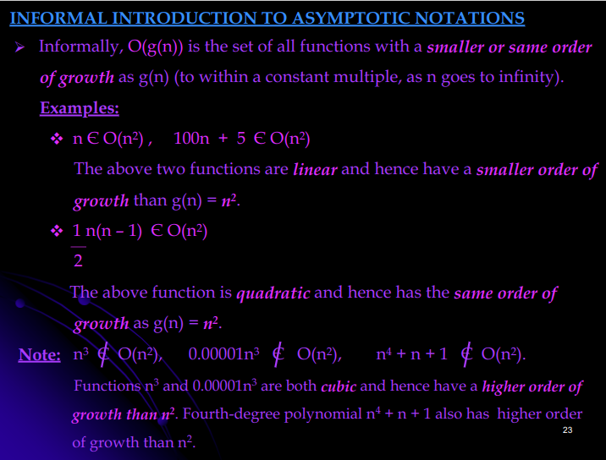
MIT School of Computing Department of Computer Science & Engineering
PLD

Slide 36
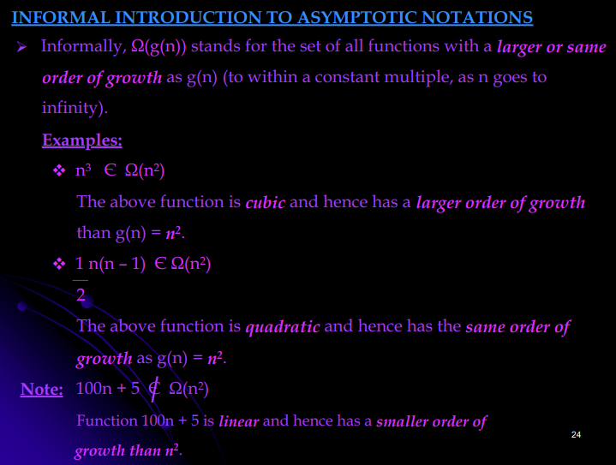
MIT School of Computing Department of Computer Science & Engineering
PLD

Slide 37
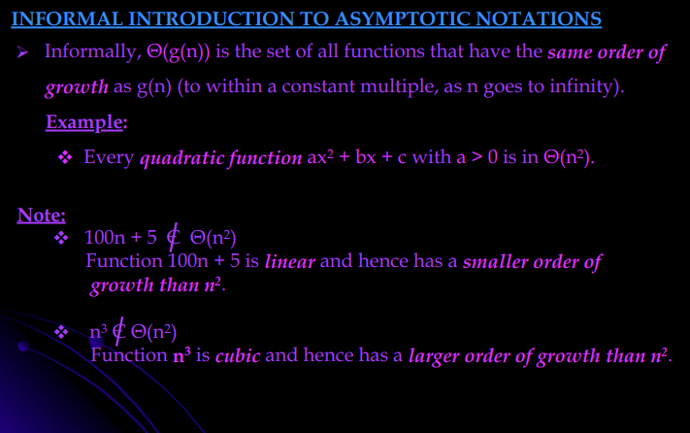
MIT School of Computing Department of Computer Science & Engineering
PLD

Slide 38
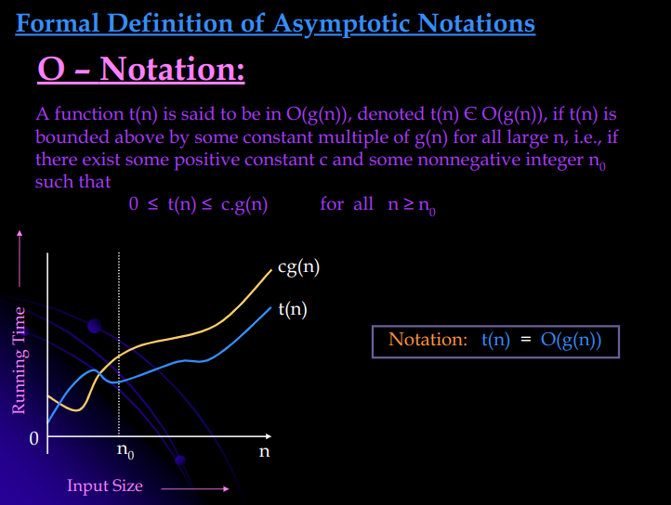
MIT School of Computing Department of Computer Science & Engineering
PLD

Slide 39
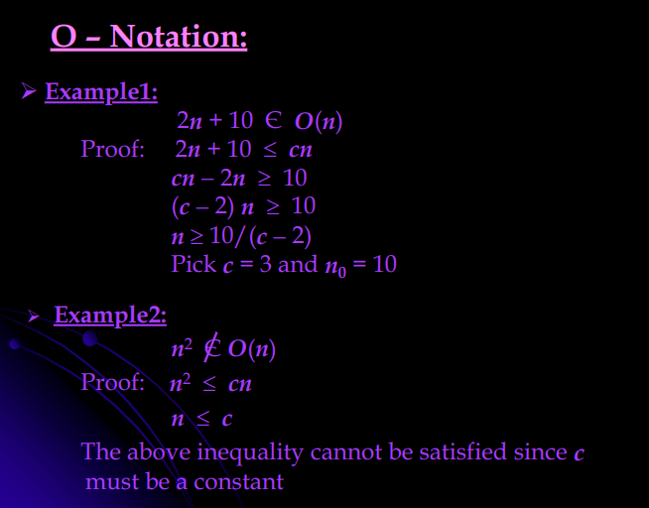
MIT School of Computing Department of Computer Science & Engineering
PLD

Slide 40
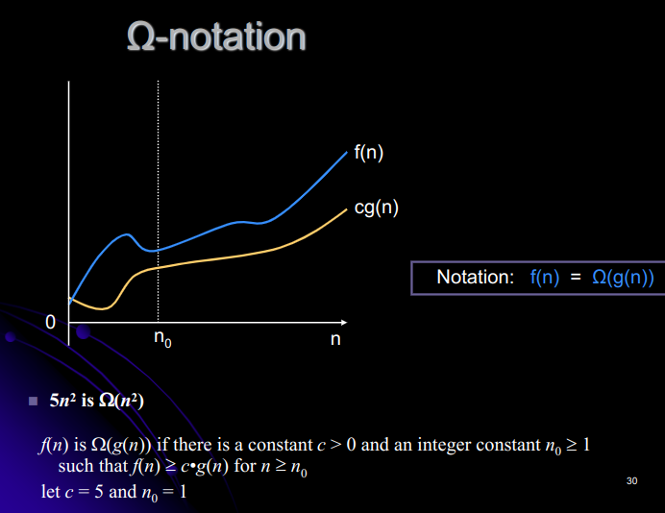
MIT School of Computing Department of Computer Science & Engineering
PLD

Slide 41
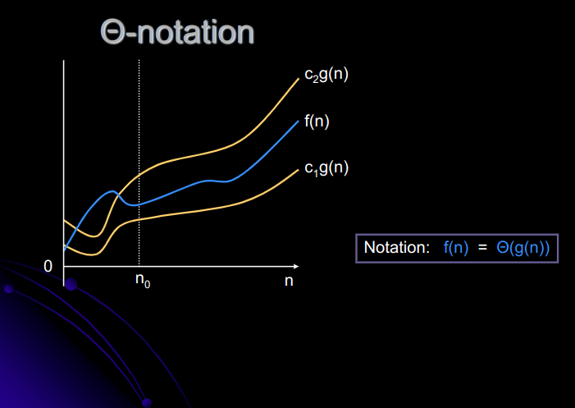
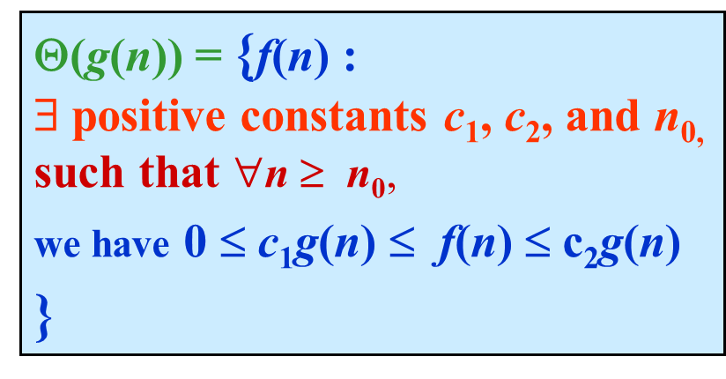
MIT School of Computing Department of Computer Science & Engineering
PLD

Slide 42
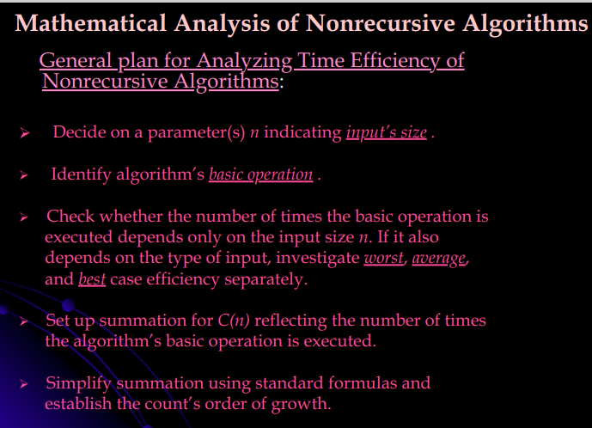
MIT School of Computing Department of Computer Science & Engineering
PLD

Slide 43
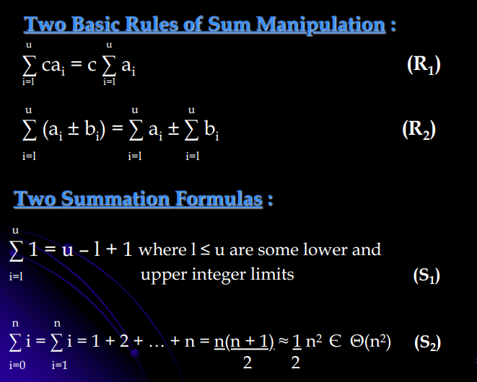
MIT School of Computing Department of Computer Science & Engineering
PLD

Slide 44
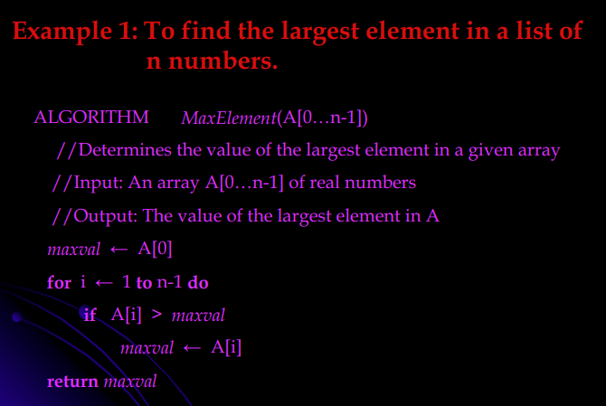
MIT School of Computing Department of Computer Science & Engineering
PLD

Slide 45
MIT School of Computing Department of Computer Science & Engineering
Algorithm analysis:
The measure of an input’s size here is the number of elements in the array, i.e., n.
• There are two operations in the for loop’s body:
o The comparison A[i]> maxval and
o The assignment max val←A[i].
• The comparison operation is considered as the algorithm basic operation, because the comparison is executed on each repetition of the loop and not the assignment.
• The number of comparisons will be the same for all arrays of size n;
therefore, there is no need to distinguish among the worst, average, and best cases here.
• Let C(n) denotes the number of times this comparison is executed. The algorithm makes one comparison on each execution of the loop, which is repeated for each value of the loop’s variable i within the bounds 1 and n − 1, inclusive.
Therefore, the sum for C(n) is calculated as follows:
PLD

Slide 46
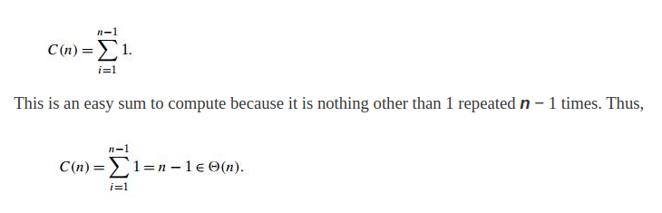
MIT School of Computing Department of Computer Science & Engineering
Therefore, we get the following sum for C(n):
PLD

Slide 47
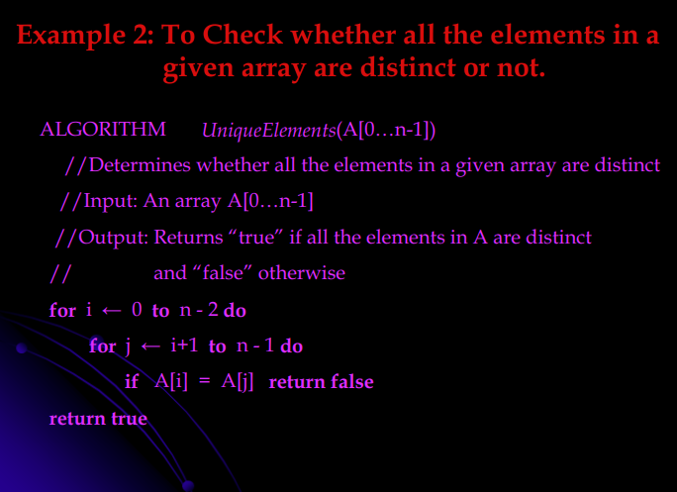
MIT School of Computing Department of Computer Science & Engineering
PLD

Slide 48
MIT School of Computing Department of Computer Science & Engineering
Algorithm analysis:
The measure of an input’s size here is the number of elements in the array, i.e., n.
• There are two Comparisons:
one comparison is made for each repetition of the innermost loop, i.e., for each value of the loop variable j between its limits i + 1 and n − 1;
The same is repeated for each value of the outer loop, i.e., for each value of the loop variable i between its limits 0 and n − 2. Accordingly, we get the for loop’s body:
PLD

Slide 49
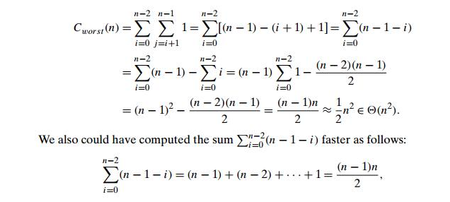
MIT School of Computing Department of Computer Science & Engineering
Algorithm analysis:
PLD

Slide 50
MIT School of Computing Department of Computer Science & Engineering
MATHEMATICAL ANALYSIS FOR RECURSIVE ALGORITHMS
General Plan for Analyzing the Time Efficiency of Recursive Algorithms
Decide on a parameter (or parameters) indicating an input's size.
Identify the algorithm's basic operation.
Check whether the number of times the basic operation is executed can vary on different inputs of the same size; if it can, the worst-case, average-case, and best-case efficiencies must be investigated separately.
Set up a recurrence relation, with an appropriate initial condition, for the number of times the basic operation is executed.
Solve the recurrence or, at least, ascertain the order of growth of its solution.
PLD

Slide 51
MIT School of Computing Department of Computer Science & Engineering
Recursive Evaluation of n! (factorial)
Definition:
n! = 1 * 2 * ... *(n-1) * n
for,
n1 and 0! = 1
Recursive definition of n! :
F(n) = F(n-1)*n
for,
n >= 1 and F(0) = 1
PLD

Slide 52
MIT School of Computing Department of Computer Science & Engineering
Algorithm Analysis - ALGORITHM F(n)
//Computes n! recursively
//Input: A nonnegative integer n
//Output: The value of n!
if n = 0, return 1
else, return F(n - 1)*n
PLD

Slide 53
MIT School of Computing Department of Computer Science & Engineering
Algorithm Analysis
M(n)= M(n − 1) + 1 for n > 0 to compute to multiply F(n-1) F(n-1) by n
M(n)= M(n − 1) +1 for n>0 M(0) = 0
M(0) = 0
the calls stop when n=0 no multiplications when n = 0
PLD

Slide 54
MIT School of Computing Department of Computer Science & Engineering
Algorithm Analysis
M(n)= M(n − 1) + 1 for n > 0 to compute to multiply F(n-1) F(n-1) by n
M(n)= M(n − 1) +1 for n>0 M(0) = 0
M(0) = 0
the calls stop when n=0 no multiplications when n = 0
PLD

Slide 55
MIT School of Computing Department of Computer Science & Engineering
Algorithm Analysis using back substitution method
M(n) = M(n − 1)+1
M(n-1) = M(n-2) + 1; //substitute M(n − 1) = M(n − 2) +1
M(n-2) = M(n-3)+1 //substitute M(n − 2) = M(n − 3) +1
M(n) = [M(n-2)+1] + 1 = M(n-2) + 2 = [M(n-3)+1+2] = M(n-3) + 3 =M(n-n) + n = n Overall time Complexity: O(n)
PLD

Slide 56
MIT School of Computing Department of Computer Science & Engineering
Master Theorem: Solving recurrence relations using master theorem
MASTER THEOREM
To solve a recurrence relation running time you can use many different techniques. One popular technique is to use the Master Theorem also known as the Master Method. “ In the analysis of algorithms, the master theorem provides a solution in asymptotic terms (using Big O notation) for recurrence relations of types that occur in the analysis of many divide and conquer algorithms.
PLD

Slide 57
MIT School of Computing Department of Computer Science & Engineering
Master Theorem: Solving recurrence relations using master theorem
MASTER THEOREM
To solve a recurrence relation running time you can use many different techniques. One popular technique is to use the Master Theorem also known as the Master Method. “ In the analysis of algorithms, the master theorem provides a solution in asymptotic terms (using Big O notation) for recurrence relations of types that occur in the analysis of many divide and conquer algorithms.
PLD

Slide 58
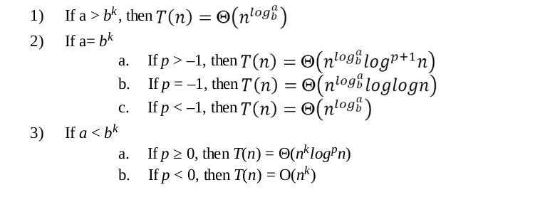
MIT School of Computing Department of Computer Science & Engineering
Master Theorem: Solving recurrence relations using master theorem
A Relation is Said to be Recurrence relation if it is in the following form
T(n) =a T(n / b) + f(n)
In such cases As per master theorem:
PLD

Slide 59
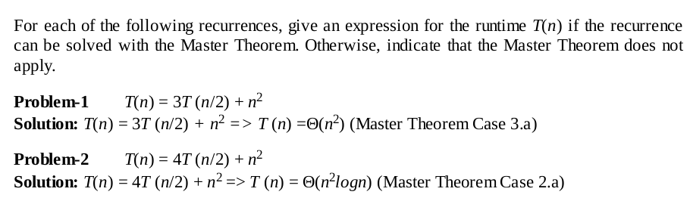
MIT School of Computing Department of Computer Science & Engineering
Master Theorem: Solving recurrence relations using master theorem
PLD

Slide 60
MIT School of Computing Department of Computer Science & Engineering
1) Problem: T (n) = 3T (n/2) + n²
Solution:T (n) = Θ(n²)
2)Problem:T (n) = 4T (n/2) + n ²
Solution:T(n) = Θ(n ² log n)
3)Problem: T (n) = T (n/2) + 2n
Solution:Θ(2n )
PLD

Slide 61
MIT School of Computing Department of Computer Science & Engineering
4) Problem:T (n) = 2^{n}T (n/2) + n ^{n}
Solution:Does not apply (a is not constant)
5) Problem:T (n) = 16T (n/4) + n
Solution:T (n) = Θ(n 2 )
PLD

Slide 62
MIT School of Computing Department of Computer Science & Engineering
Thank You
PLD

